Slide 1
CSCI 475/585 Information Security and Privacy Fall 2019
Chapter 2 – Cryptographic Tools
Week 2
2.2 Asymmetric Encryption
Notes:
Lecture slides prepared by Dr Lawrie Brown (UNSW@ADFA) for “Computer Security: Principles and Practice”, by William Stallings and Lawrie Brown, Chapter 2 “Cryptographic Tools”.
Enhanced and Modified by Chuan Yue at the Colorado School of Mines.

Slide 2
Secret-Key Cryptography
traditional symmetric/secret/single key cryptography uses one key
shared by both sender and receiver
if this key is disclosed, communications are compromised
also is symmetric, parties are equal
does not protect sender from receiver forging a message & claiming is sent by sender
does not protect receiver from sender denying sending a message
Notes:
The development of public-key cryptography is the greatest and perhaps the only true revolution in the entire history of cryptography. From its earliest beginnings to modern times, virtually all cryptographic systems have been based on the elementary tools of substitution and permutation, and can be classed as private/secret/single key (symmetric) systems. All classical, and modern block and stream ciphers are of this form.

Slide 3
Public-Key Cryptography
probably the most significant advance in the 3000 year history of cryptography
uses two keys – a public key & a private key
asymmetric since parties are not equal
uses clever application of number theoretic concepts to function
complements rather than replaces private key cryptography
Notes:
Will now discuss the radically different public key systems, in which two keys are used. Public-key cryptography provides a radical departure from all that has gone before. The development of public-key cryptography is the greatest and perhaps the only true revolution in the entire history of cryptography. It is asymmetric, involving the use of two separate keys, in contrast to symmetric encryption, that uses only one key. Anyone knowing the public key can encrypt messages or verify signatures, but cannot decrypt messages or create signatures, counter-intuitive though this may seem. The use of two keys has profound consequences in the areas of confidentiality, key distribution, and authentication. It works by the clever use of number theory problems that are easy one way but hard the other. Note that public key schemes are neither more nor less secure than private key (security depends on the key size for both), nor do they replace private key schemes (they are too slow to do so), rather they complement them. Both also have issues with key distribution, requiring the use of some suitable protocol.

Slide 4
Misconceptions about Public-Key Cryptography
public-key encryption is more secure
there is nothing in principle to show one is superior to another from the point of view of resisting cryptanalysis.
public- key encryption is a general- purpose technique that has made symmetric encryption obsolete.
because of the computational overhead of current public-key encryption schemes, there seems no foreseeable likelihood …
key distribution is trivial in public-key encryption
the procedures involved are not simpler nor any more efficient than those required for symmetric encryption

Slide 5
Why Public-Key Cryptography?
developed to address two key issues:
key distribution – how to have secure communications in general without having to trust a KDC with your key
digital signatures – how to protect two parties against each other
public invention due to Whitfield Diffie & Martin Hellman at Stanford Univ. in 1976: “New Directions in Cryptography” (2015 ACM A.M. Turing Award)
known earlier in classified community
Notes:
Modified by Chuan Yue at the Colorado School of Mines.
The concept of public-key cryptography evolved from an attempt to attack two of the most difficult problems associated with symmetric encryption: key distribution and digital signatures. The first problem is that of key distribution, which under symmetric encryption requires either (1) that two communicants already share a key, which somehow has been distributed to them; or (2) the use of a key distribution center. This seemed to negated the very essence of cryptography: the ability to maintain total secrecy over your own communication. The second was that of "digital signatures." If the use of cryptography was to become widespread, not just in military situations but for commercial and private purposes, then electronic messages and documents would need the equivalent of signatures used in paper documents.
The idea of public key schemes, and the first practical scheme, which was for key distribution only, was published in 1976 by Diffie & Hellman. The concept had been previously described in a classified report in 1970 by James Ellis (UK CESG) - and subsequently declassified [ELLI99]. Its interesting to note that they discovered RSA first, then Diffie-Hellman, opposite to the order of public discovery! There is also a claim that the NSA knew of the concept in the mid-60’s [SIMM93].

Slide 6
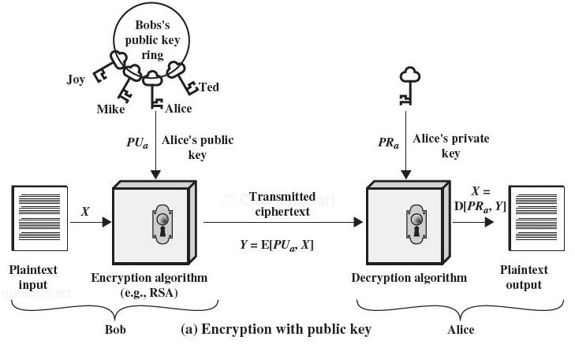
Encryption with Public Key
Y = E(PU_{a}, X)
X = D(PR_{a}, Y)
(provides confidentiality)
Notes:
Added by Chuan Yue at the Colorado School of Mines.

Slide 7
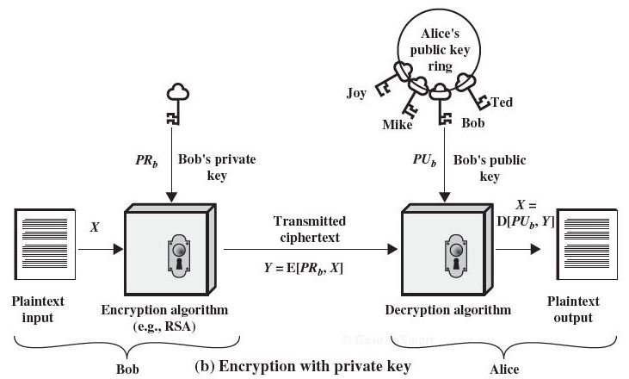
Encryption with Private Key
Y = E(PR_{b}, X)
X = D(PU_{b}, Y)
(Y serves as a
digital signature)
(provides authentication: source and
the integrity of the message )
Notes:
Added by Chuan Yue at the Colorado School of Mines.

Slide 8
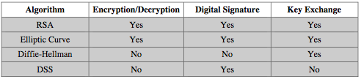
Applications for Public-Key Algorithms
can classify uses into 3 categories:
encryption/decryption (provide confidentiality)
digital signatures (provide authentication)
key exchange (of session keys)
some algorithms are suitable for all uses, others are specific to one

Slide 9
Public-key Cryptanalysis
like secret key schemes brute force exhaustive key search attack is always theoretically possible
a tradeoff on key size
Computing the private key given the public key could be feasible
it has not been mathematically proven this type of attack is infeasible for a particular public-key algorithm
any given algorithm, including RSA, is suspect
advances in theory of computation, number theory, or new (e.g., quantum) computing models/computers.
Notes:
Modified by Chuan Yue at the Colorado School of Mines.
Public key schemes are no more or less secure than private key schemes - in both cases the size of the key determines the security. As with symmetric encryption, a public-key encryption scheme is vulnerable to a brute-force attack. The countermeasure is the same: Use large keys. However, there is a tradeoff to be considered. Public-key systems depend on the use of some sort of invertible mathematical function. The complexity of calculating these functions may not scale linearly with the number of bits in the key but grow more rapidly than that. Thus, the key size must be large enough to make brute-force attack impractical but small enough for practical encryption and decryption. In practice, the key sizes that have been proposed do make brute-force attack impractical but result in encryption/decryption speeds that are too slow for general-purpose use. Instead, as was mentioned earlier, public-key encryption is currently confined to key management and signature applications. Another form of attack is to find some way to compute the private key given the public key. To date, it has not been mathematically proven that this form of attack is infeasible for a particular public-key algorithm.
Note also that you can't compare key sizes - a 64-bit private key scheme has very roughly similar security to a 512-bit RSA - both could be broken given sufficient resources. But with public key schemes at least there is usually a firmer theoretical basis for determining the security since its based on well-known and well studied number theory problems.

Slide 10
RSA
by Rivest, Shamir & Adleman of MIT in 1977
best known & widely used public-key scheme
a block cipher, the plaintext and ciphertext are integers between 0 and n-1 for some n
a typical size for n is 1024 bits
security is based on the difficulty of finding the prime factors of a large composite number
Notes:
RSA is the best known, and by far the most widely used general public key encryption algorithm, and was first published by Rivest, Shamir & Adleman of MIT in 1978 [RIVE78]. The Rivest-Shamir-Adleman (RSA) scheme has since that time reigned supreme as the most widely accepted and implemented general-purpose approach to public-key encryption. It is based on exponentiation in a finite (Galois) field over integers modulo a prime, using large integers (eg. 1024 bits). Its security is due to the cost of factoring large numbers.

Slide 11
RSA En/decryption
to encrypt a message M the sender:
obtains public key of recipient PU={e,n}
computes: C = Me mod n, where 0≤M<n
to decrypt the ciphertext C the owner:
uses the private key PR={d,n}
computes: M = C^{d} mod n
=(Me mod n)^{d} mod n
=(Me)^{d} mod n
= M^{ed} mod n
Notes:
The scheme developed by Rivest, Shamir, and Adleman makes use of an expression with exponentials. Plaintext is encrypted in blocks, with each block having a binary value less than some number n. The actual RSA encryption and decryption computations are each simply a single exponentiation mod (n). Both sender and receiver must know the value of n. The sender knows the value of e, and only the receiver knows the value of d. Thus, this is a public-key encryption algorithm with a public key of PU = {e, n} and a private key of PR = {d, n}. Note that the message must be smaller than the modulus. The “magic” is in the choice of the modulus and exponents which makes the system work.

Slide 12
RSA Example - Key Setup
Select primes: p=17 & q=11
Calculate n = pq =17 x 11=187
Calculate ø(n)=(p–1)(q-1)=16*10=160
(// Euler Totient Function)
Select e: gcd(e,160)=1; choose e=7
Determine d: d.e ≡ 1 mod 160 and d < 160 Value is d=23 since 23*7=161= 1*160+1
(extended Euclid’s algorithm ax+by=1)
Publish public key PU={7,187}
Keep secret private key PR={23,187}

Slide 13
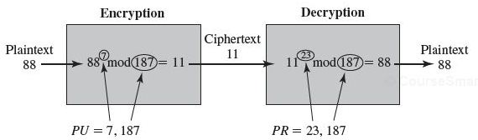
RSA Example - En/Decryption
sample RSA encryption/decryption
PU={7,187}, PR={23,187}
given message M = 88 (note 88<187)
encryption: C = 88⁷ mod 187 = 11
decryption: M = 11²³ mod 187 = 88
Notes:
Then show that the encryption and decryption operations are simple exponentiations mod 187.
Rather than having to laborious repeatedly multiply, can use the "square and multiply" algorithm with modulo reductions to implement all exponentiations quickly and efficiently (see next).

Slide 14
RSA Security
possible approaches to attacking RSA are:
brute force key search - infeasible given size of numbers
mathematical attacks - based on difficulty of factoring n to primes p and q
timing attacks - on running of decryption
chosen ciphertext attacks - given properties of RSA
Notes:
Note some possible possible approaches to attacking the RSA algorithm, as shown.
The defense against the brute-force approach is the same for RSA as for other cryptosystems, namely, use a large key space. Thus the larger the number of bits in d, the better. However because the calculations involved both in key generation and in encryption/decryption are complex, the larger the size of the key, the slower the system will run.
Will now review the other possible types of attacks.

Slide 15
Random Numbers
many uses of random numbers in cryptography
nonces in authentication protocols to prevent replay
session keys generation
generation of keys for public-key encryption algorithms
keystream for symmetric stream encryption
two distinct and not necessarily compatible requirements for a sequence of random numbers
randomness: the sequence of numbers be statistically random
unpredictability: the successive members of the sequence are unpredictable
Notes:
Random numbers play an important role in the use of encryption for various network security applications. In this section, we provide a brief overview of the use of random numbers in cryptography and network security and then focus on the principles of pseudorandom number generation. Getting good random numbers is important, but difficult. You don't want someone guessing the key you're using to protect your communications because your "random numbers" weren't (as happened in an early release of Netscape SSL). Traditionally, the concern in the generation of a sequence of allegedly random numbers has been that the sequence of numbers be random in some well-defined statistical sense (with uniform distribution & independent). In applications such as reciprocal authentication, session key generation, and stream ciphers, the requirement is not just that the sequence of numbers be statistically random but that the successive members of the sequence are unpredictable (so that it is not possible to predict future values having observed previous values). With "true" random sequences, each number is statistically independent of other numbers in the sequence and therefore unpredictable. However, as is discussed shortly, true random numbers are seldom used; rather, sequences of numbers that appear to be random are generated by some algorithm.

Slide 16
Pseudorandom vs. True Random Numbers
often use deterministic algorithms to generate pseudorandom numbers
although are not truly random
can pass many reasonable tests of “randomness”
special algorithms, or algorithms based on existing cryptographic algorithms
true random number generators use a nondeterministic source
eg. radiation counters, radio noise, audio noise, thermal noise in diodes, leaky capacitors, mercury discharge tubes
Notes:
Cryptographic applications typically make use of algorithmic techniques for random number generation. These algorithms are deterministic and therefore produce sequences of numbers that are not statistically random. However, if the algorithm is good, the resulting sequences will pass many reasonable tests of randomness. Such numbers are referred to as pseudorandom numbers.
A true random number generator (TRNG) uses a nondeterministic source to produce randomness. Most operate by measuring unpredictable natural processes, such as pulse detectors of ionizing radiation events, gas discharge tubes, and leaky capacitors. Increasingly have true random sources in modern computer chips.

Slide 17
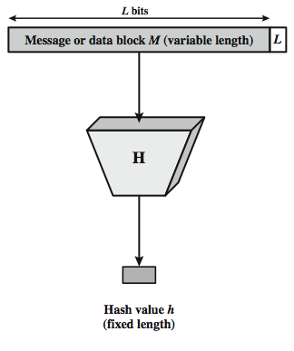
Cryptographic Hash Functions
condenses variable-length message to fixed size
h = H(M)
used to detect changes to message (data integrity)
Notes:
A hash function H accepts a variable-length block of data M as input and produces a fixed-size hash value h = H(M). A "good" hash function has the property that the results of applying the function to a large set of inputs will produce outputs that are evenly distributed, and apparently random. In general terms, the principal object of a hash function is data integrity. A change to any bit or bits in M results, with high probability, in a change to the hash code. The kind of hash function needed for security applications is referred to as a cryptographic hash function. A cryptographic hash function is an algorithm for which it is computationally infeasible (because no attack is significantly more efficient than brute force) to find either (a) a data object that maps to a pre-specified hash result (the one-way property) or (b) two data objects that map to the same hash result (the collision-free property). Because of these characteristics, hash functions are often used to determine whether or not data has changed.

Slide 18
Other Hash Function Uses
to create a one-way password file
store hash of password not actual password
for intrusion detection and virus detection
keep & check hash of files on system
keep H(F) secure, compute and compare later
pseudorandom number generator

Slide 19
Hash Function Requirements
applied to any size data
H produces a fixed-length output.
H(x) is relatively easy to compute for any given x
one-way property
computationally infeasible to find x such that H(x) = h
weak collision resistance
computationally infeasible to find y ≠ x such that H(y) = H(x)
strong collision resistance
computationally infeasible to find any pair (x, y) such that H(x) = H(y)
Notes:
The purpose of a hash function is to produce a "fingerprint" of a file, message, or other block of data. To be useful for message authentication, a hash function H must have the properties listed here. The first three properties are requirements for the practical application of a hash function to message authentication. The fourth property is the one-way property: it is easy to generate a code given a message, but virtually impossible to generate a message given a code. This property is important if the authentication technique involves the use of a secret value (such as shown in Figure 2.5c). The fifth property guarantees that it is impossible to find an alternative message with the same hash value as a given message. This prevents forgery when an encrypted hash code is used (as in Figures 2.5a and b). A hash function that satisfies the first five properties in the preceding list is referred to as a weak hash function. If the sixth property is also satisfied, then it is referred to as a strong hash function. The sixth property protects against a sophisticated class of attack known as the birthday attack. In addition to providing authentication, a message digest also provides data integrity. It performs the same function as a frame check sequence: if any bits in the message are accidentally altered in transit, the message digest will be in error.

Slide 20
Message Security Requirements
disclosure
traffic analysis
masquerade
content modification
sequence modification
timing modification
source repudiation
destination repudiation
Confidentiality
Message Authentication
Digital Signature
Notes:
In the context of communications across a network, the attacks listed above can be identified, with more detail given in the text. The first two requirements (Disclosure: Release of message contents; and Traffic analysis: Discovery of the pattern of traffic between parties) belong in the realm of message confidentiality, and are handled using the encryption techniques already discussed. Measures to deal with items 3 through 6 (Masquerade: Insertion of messages into the network from a fraudulent source; Content modification: of the contents of a message; Sequence modification: to a sequence of messages between parties; and Timing modification: Delay or replay of messages) are generally regarded as message authentication. Mechanisms for dealing specifically with item 7 (Source repudiation: Denial of transmission of message by source) come under the heading of digital signatures. Generally, a digital signature technique will also counter some or all of the attacks listed under items 3 through 6. Dealing with item 8 (Destination repudiation: Denial of receipt of message by destination) may require a combination of the use of digital signatures and a protocol designed to counter this attack.
In summary, message authentication is a procedure to verify that received messages come from the alleged source and have not been altered. Message authentication may also verify sequencing and timeliness. A digital signature is an authentication technique that also includes measures to counter repudiation by the source.

Slide 21
Message Authentication
message authentication is concerned with:
protecting the integrity of a message
validating identity of originator
message authentication & digital signature both use some lower-level function to generate an authenticator
three classes of low-level functions can be used
hash function
message encryption
message authentication code (MAC)

Slide 22
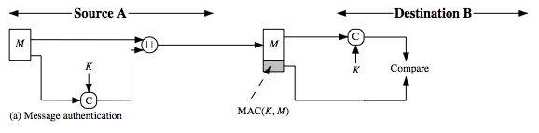
Message Authentication Code
a small fixed-sized block of data
generated from message + secret key
MAC = C(K,M)
appended to message when sent
automatically compared at the destination
provides authentication

Slide 23
Digital Signatures
have looked at message authentication
but does not address issues of trust between two parties
the receiver can forge a message
the sender can deny sending a message
digital signatures provide the ability to:
verify the author and the date and time of the signature
authenticate the contents at the time of the signature
be verifiable by third parties, to resolve disputes
hence include authentication function with additional capabilities
Notes:
The most important development from the work on public-key cryptography is the digital signature. Message authentication protects two parties who exchange messages from any third party. However, it does not protect the two parties against each other either fraudulently creating, or denying creation, of a message. A digital signature is analogous to the handwritten signature, and provides a set of security capabilities that would be difficult to implement in any other way. It must have the following properties:
• It must verify the author and the date and time of the signature
• It must to authenticate the contents at the time of the signature
• It must be verifiable by third parties, to resolve disputes
Thus, the digital signature function includes the authentication function.

Slide 24
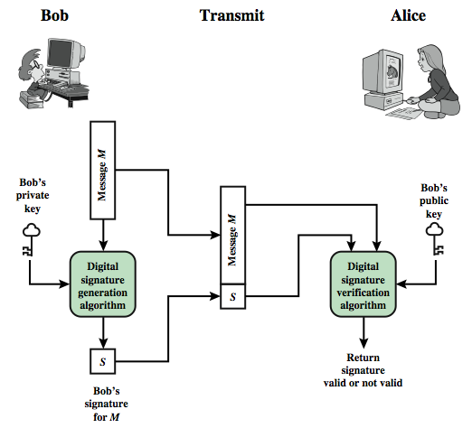
General Model of Digital Signature Process

Slide 25
Key Management and Distribution
symmetric key distribution using symmetric encryption
symmetric key distribution using asymmetric encryption
distribution of public keys
public-key authority
public-key certificates
X.509 certificates
PKI (public-key infrastructure)

Slide 26
Key Hierarchy
typically have a hierarchy of keys
session key
temporary key
used for encryption of data between users
for one logical session then discarded
master key
used to encrypt session keys
shared between user & key distribution center
distributed by using public key cryptography
Notes:
For end-to-end encryption, some variation on option 4 has been widely adopted. In this scheme, a key distribution center is responsible for distributing keys to pairs of users (hosts, processes, applications) as needed. Each user must share a unique key with the key distribution center for purposes of key distribution. The use of a key distribution center is based on the use of a hierarchy of keys. At a minimum, two levels of keys are used: a session key, used for the duration of a logical connection; and a master key shared by the key distribution center and an end system or user and used to encrypt the session key.

Slide 27
Public-Key Certificates
certificates allow key exchange without real-time access to public-key authority
a certificate binds identity to public key
usually with other info such as period of validity, rights of use
with all contents signed by a trusted third party called Certificate Authority (CA)
Four requirements:
Any participant can read a certificate to determine the name and public key of the certificate’s owner.
Any participant can verify that the certificate originated from the certificate authority and is not counterfeit.
Only the certificate authority can create and update certificates.
Any participant can verify the currency of the certificate.
Notes:
An further improvement, first suggested by Kohnfelder, is to use certificates, which can be used to exchange keys without contacting a public-key authority, in a way that is as reliable as if the keys were obtained directly from a public-key authority. A certificate binds an identity to public key, with all contents signed by a trusted Public-Key or Certificate Authority (CA). A user can present his or her public key to the authority in a secure manner, and obtain a certificate. The user can then publish the certificate. Anyone needing this user's public key can obtain the certificate and verify that it is valid by way of the attached trusted signature. A participant can also convey its key information to another by transmitting its certificate. Other participants can verify that the certificate was created by the authority, provided they know its public key.
One scheme has become universally accepted for formatting public-key certificates: the X.509 standard. X.509 certificates are used in most network security applications, including IP security, secure sockets layer (SSL), secure electronic transactions (SET), and S/MIME. Will discuss it in much more detail later.

Slide 28
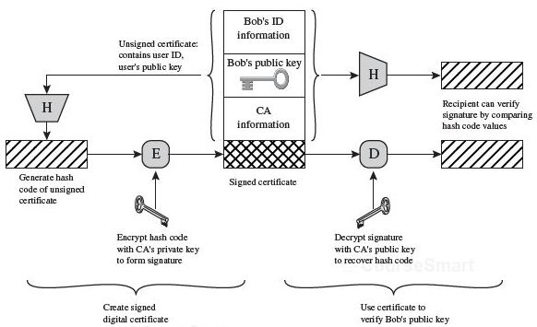
X.509 Certificate Use (SSL/TLS, IP Security, S/MIME)
Notes:
Added by Chuan Yue at the Colorado School of Mines.

Slide 29
Summary
Public-Key Cryptography
Random Numbers
Hash Functions
Message Authentication
Digital Signature
Key Management and Distribution
Public Key Certificate

